Slide 1
DR. AMBEDKAR GOVT ARTS COLLEGE VYASARPADI CHENNAI-39
DEPARTMENT OF MATHEMATICS

Slide 2
TEAM MEMBERS: 1.INDHUMATHI (TEAM LEADER) 2.PRAKASH.J 3.PRAVEEN KUMAR.S 4.SOWNDARYA.S
PROJECT GUIDED BY
DR.K.THULUKKANAM

Slide 3
PROJECT TITLE India’s Agricultural Crop Production Analysis(1997-2021)
TOOL: TABLEAU DESKTOP

Slide 4
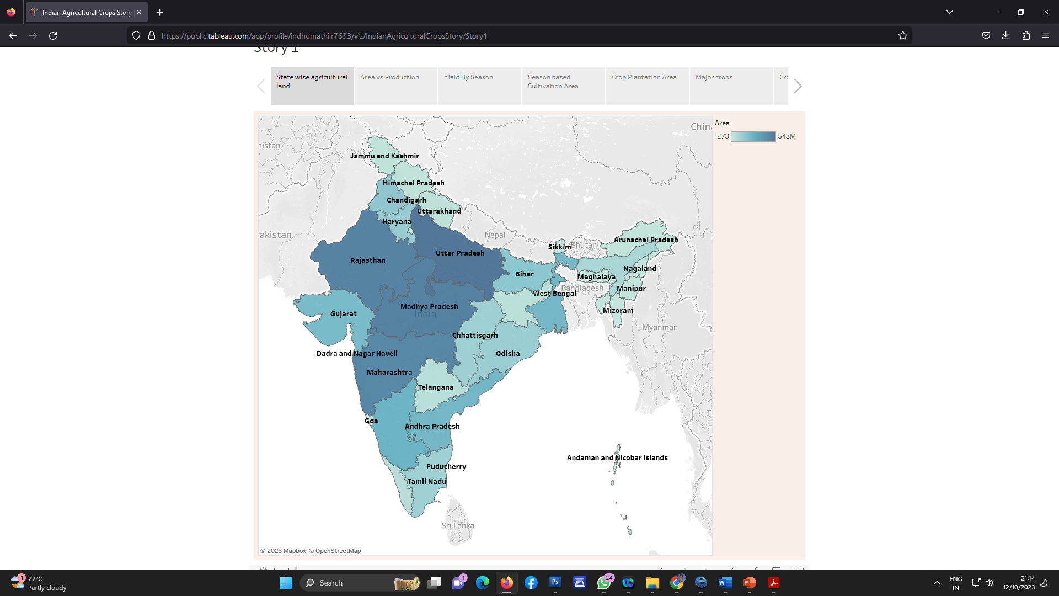
Activity 1.1 : State wise Agricultural Land IN THIS MAP WE HAVE VISULIZED THE STATE WISE AGRICULTURE LAND

Slide 5
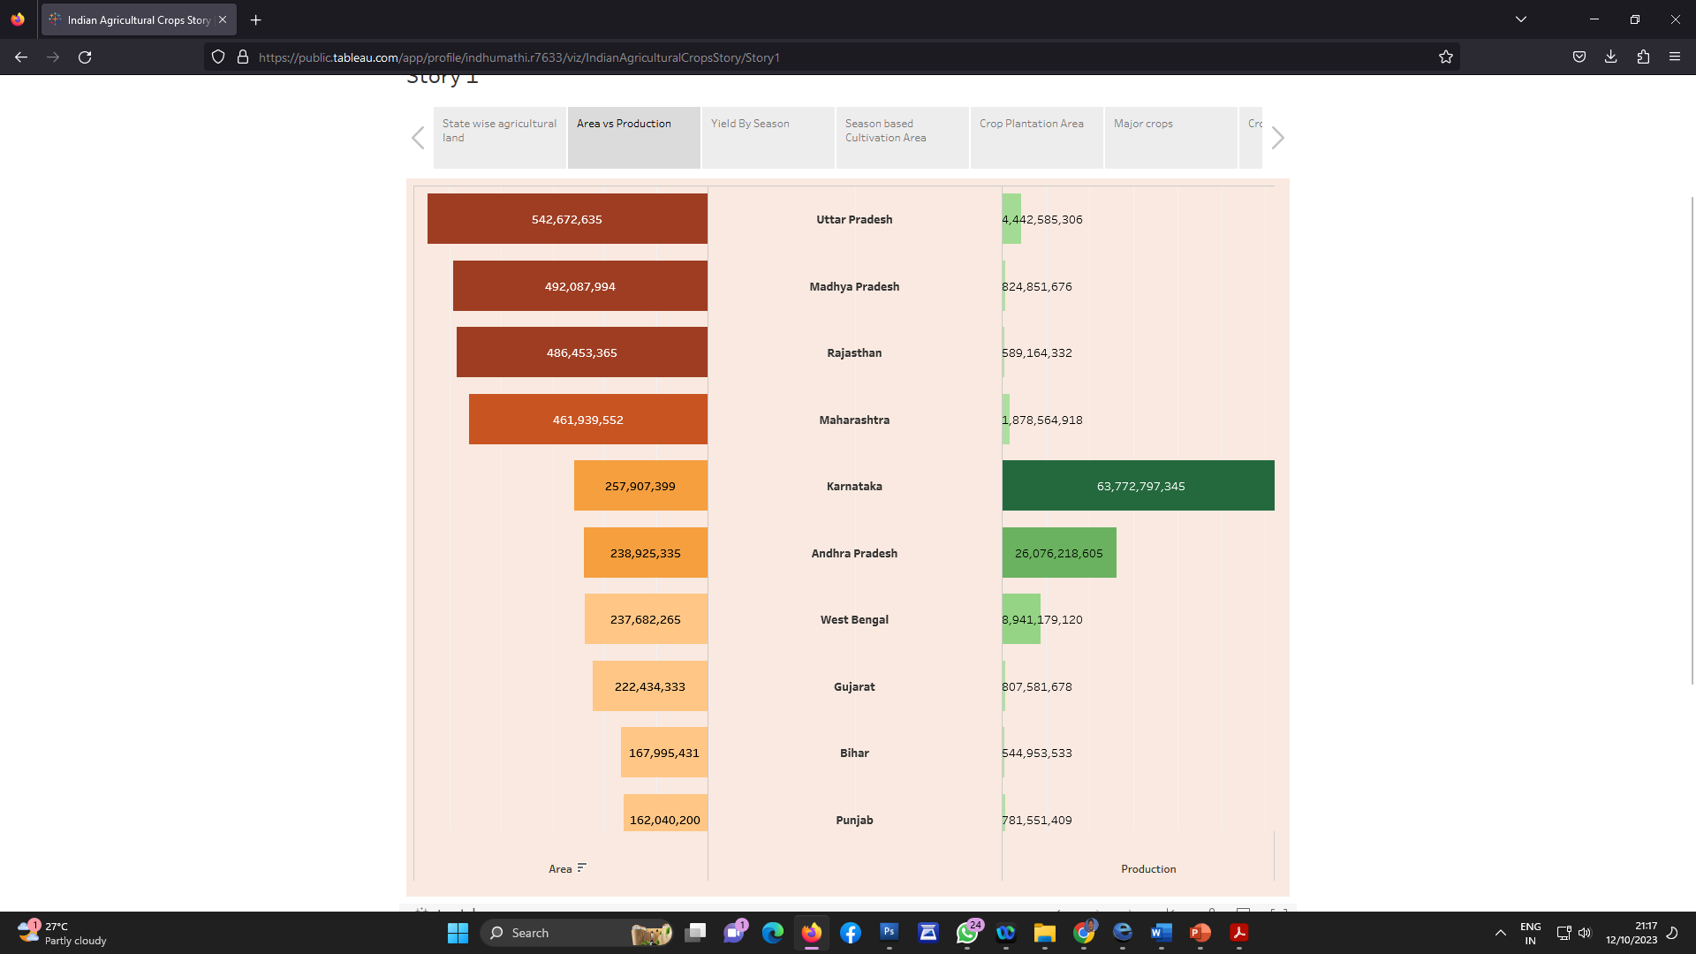
Activity 1.2 : Area vs Production

Slide 6
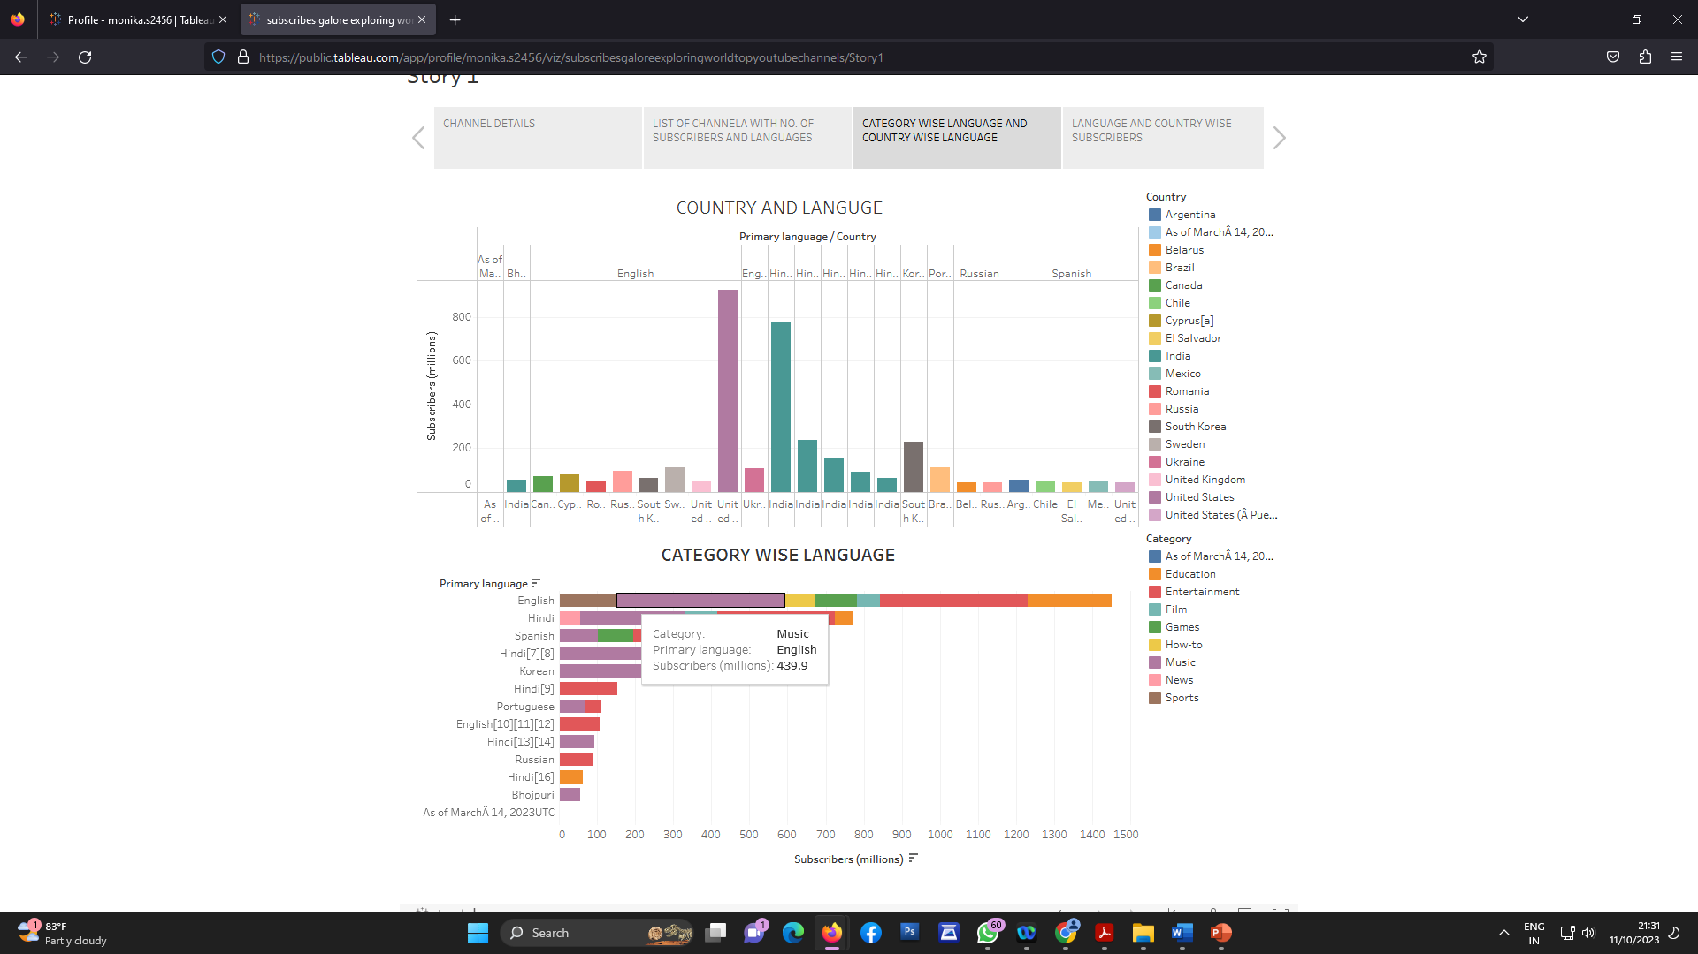
Activity 1.3 : Season based cultivation

Slide 7
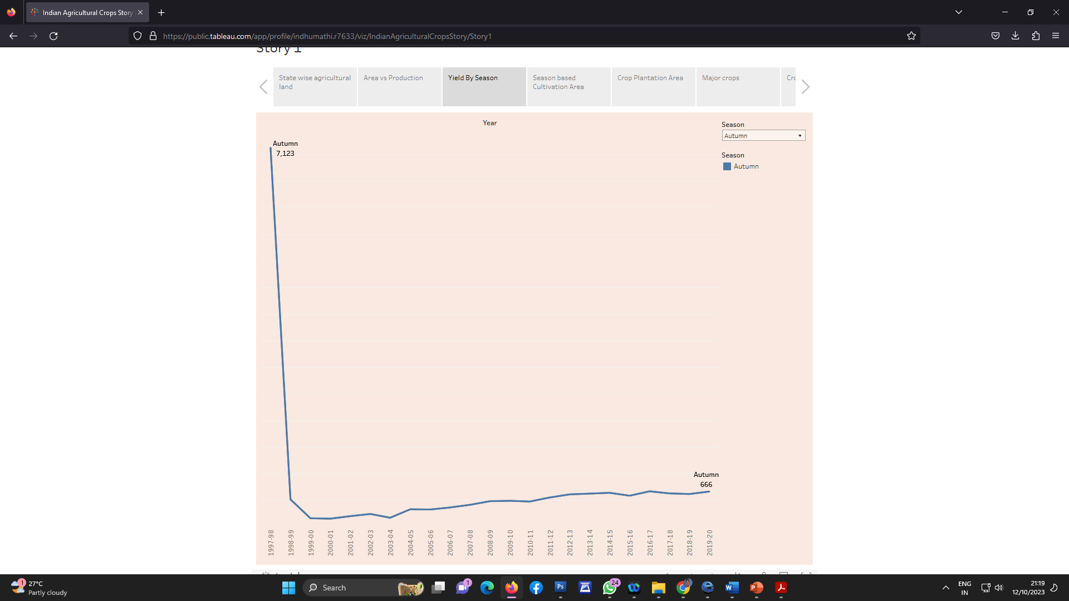
Activity 1.4 : Yield by season

Slide 8
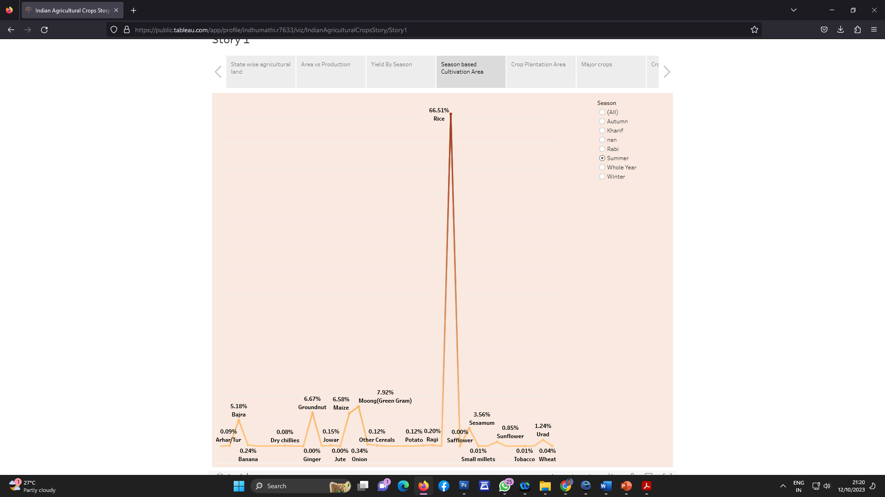
Activity 1.5 : Crop plantation by area

Slide 9
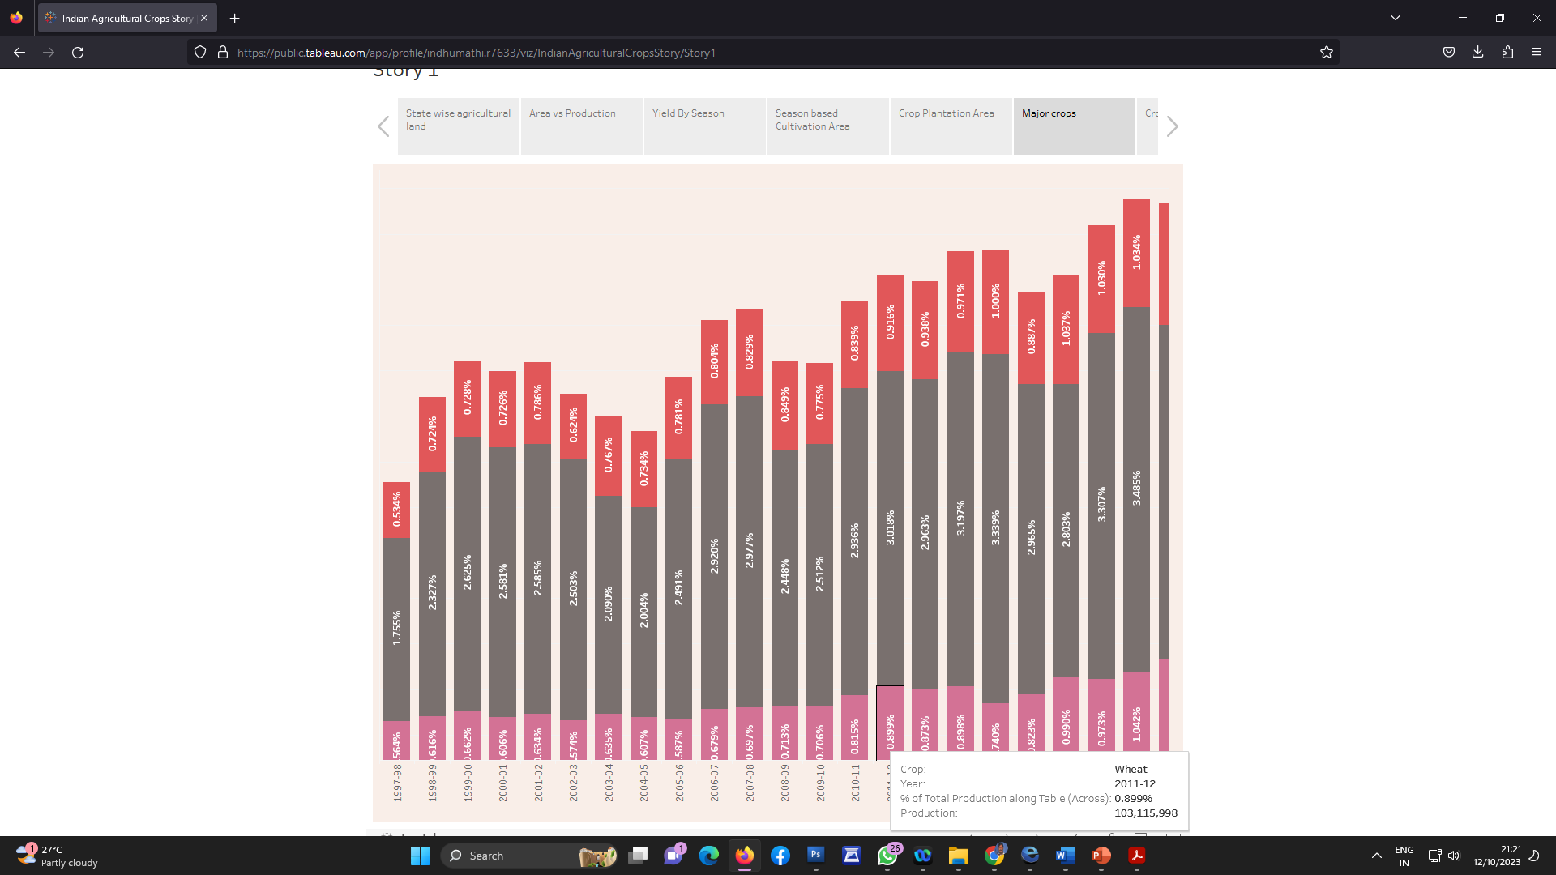
Activity 1.6 : Major crops growth Yoy

Slide 10
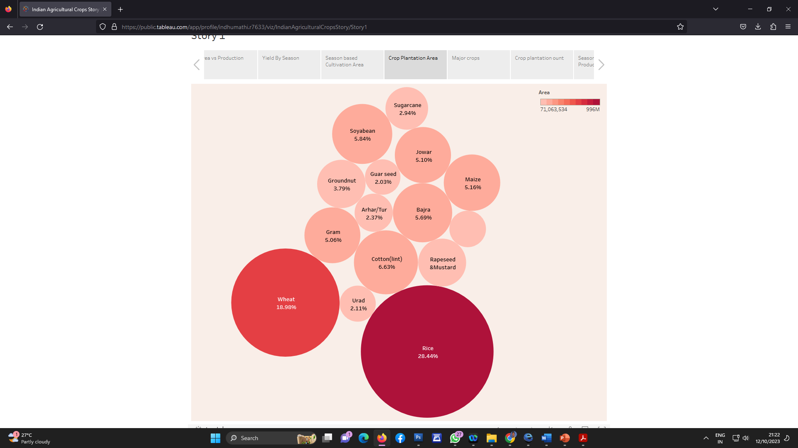
Activity 1.7 : Crops

Slide 11
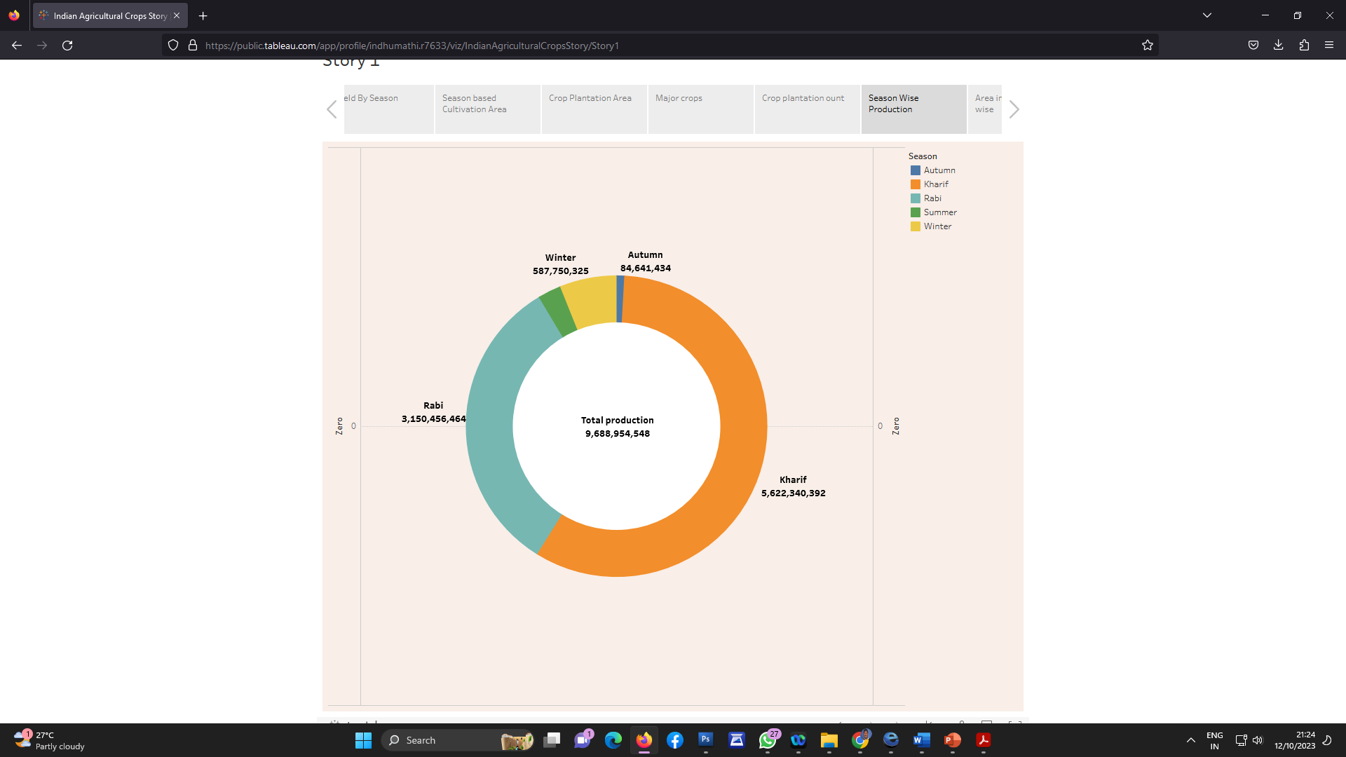
Activity 1.8 : Season wise production

Slide 12
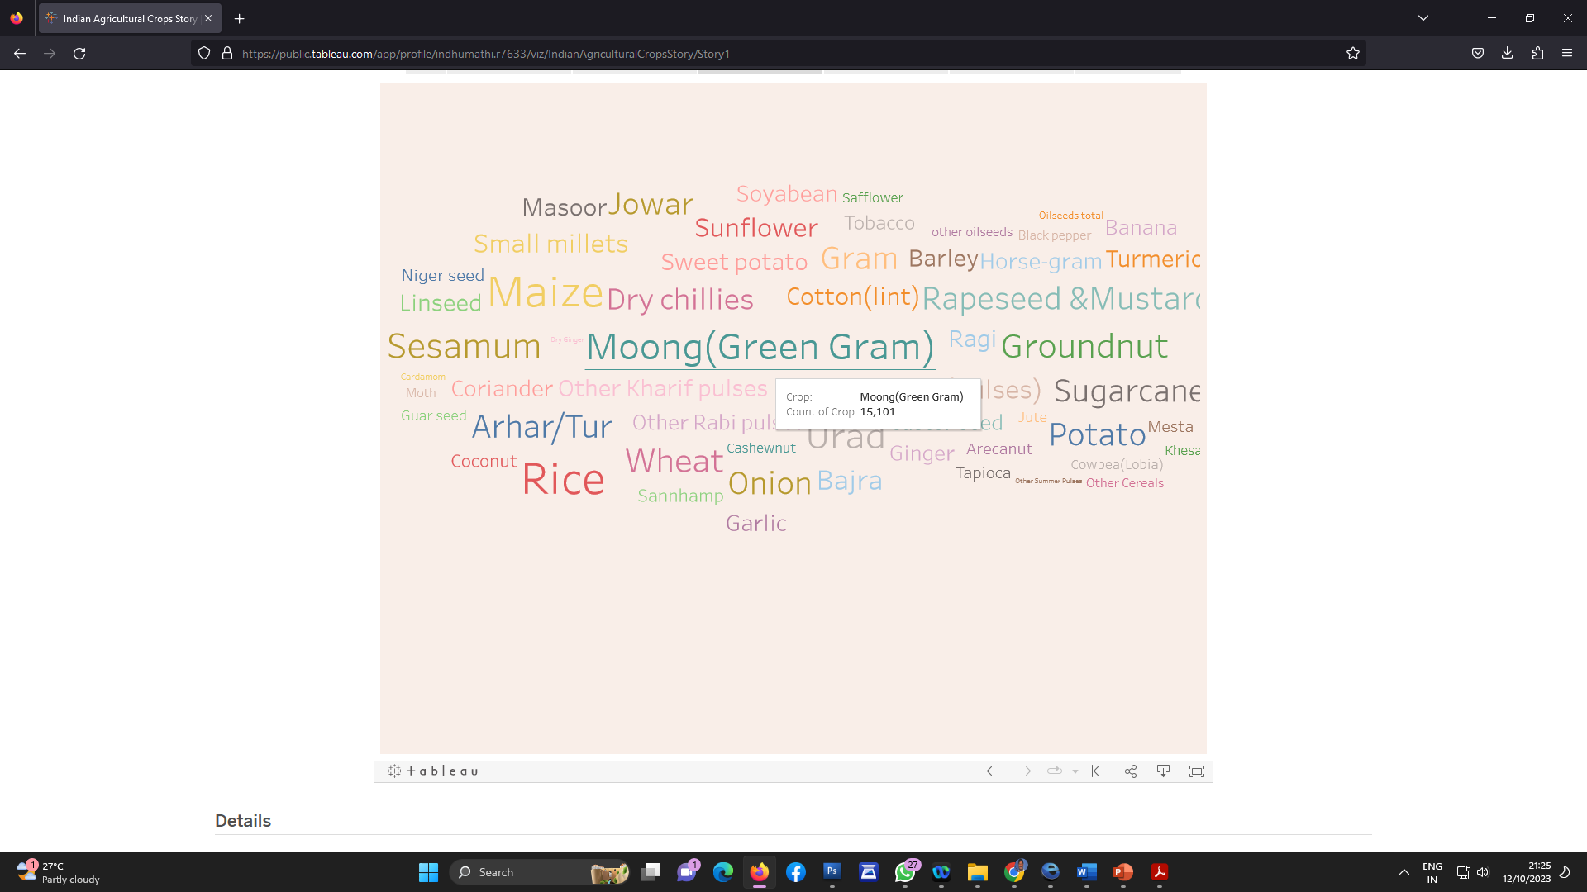
Activity 1.9 : Kpi’s

Slide 13
THANK YOU

